Slide 1




Adaptive Web Design

Slide 2
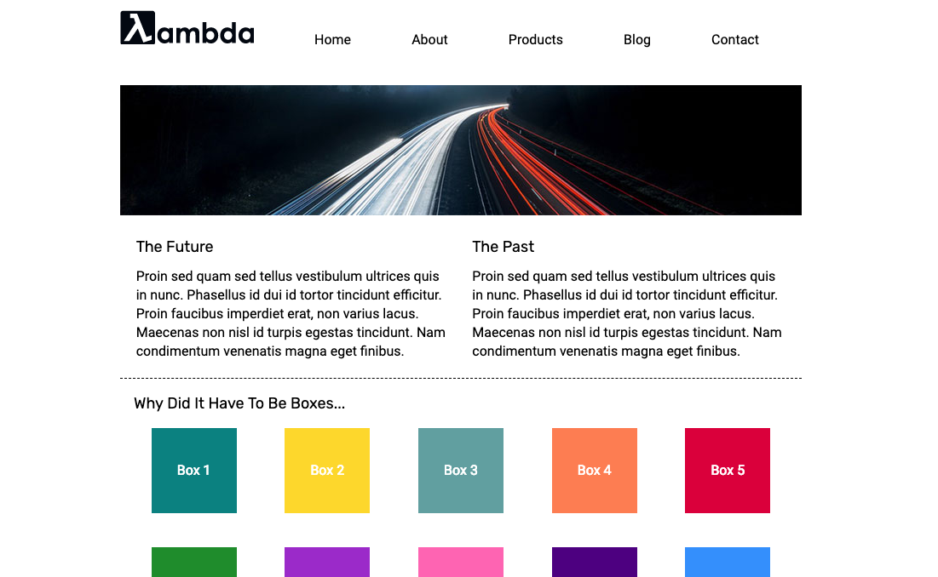

Multi-Page Website

Slide 3

Exploring CSS Fundamentals

Slide 4


